Slide 1
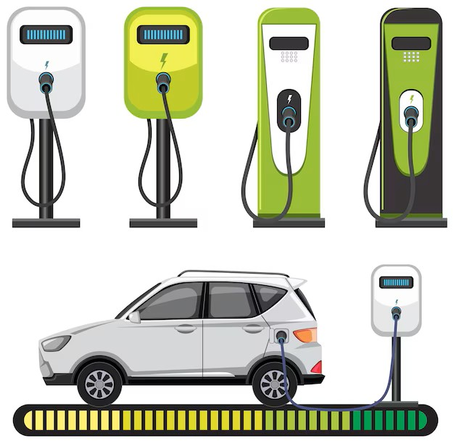
Electric Vehicle Charging Demand Forecasting
Leveraging Weather, Time, and Traffic Data with Prophet and ARIMA Models
By
Sherin Samuel

Slide 2
Project Overview
Objective: Forecast EV charging demand to support infrastructure planning
Key Features:
Integrates weather, EV population, and traffic data
Uses Prophet and ARIMA models for time-series forecasting
Visualizes trends and forecasts via an interactive Streamlit dashboard
Impact: Informs optimal placement and scaling of charging stations

Slide 3
Data Sources
Weather Data:
Source: Multiple CSV files (temperature, humidity, etc.)
Cities: 36 cities (e.g., Seattle, Vancouver, San Diego)
Rows: ~271,554
EV Population Data:
Source: Electric_Vehicle_Population_Data.csv
Rows: ~239,747
Features: EV Count, Electric Range
Traffic Data:
Source: Metro_Interstate_Traffic_Volume.csv (Minneapolis)
Rows: ~48,204
Visual: Table summarizing data sources and shapes

Slide 4
Methodology
Data Preprocessing
Combined weather files into a unified dataset
Standardized time-series data for EV demand
Handled missing data and ensured compatibility
Forecasting Models:
Prophet: Captures seasonality and trends with external regressors (weather, traffic)
ARIMA: Models stationarity with optimized parameters via grid search
Validation: RMSE for model comparison

Slide 5
Main Program Workflow
Steps
Load and validate weather, EV, and traffic data
Merge datasets into a time-series format
Apply Prophet and ARIMA for forecasting (2025–2027)
Generate visualizations (trends, scatter plots)
Produce a summary report with recommendations
Output
Combined weather data: combined_weather_data.csv
Forecast plots: prophet_forecast_*.png, arima_forecast_*.png
Report: ev_forecast_report.txt

Slide 6
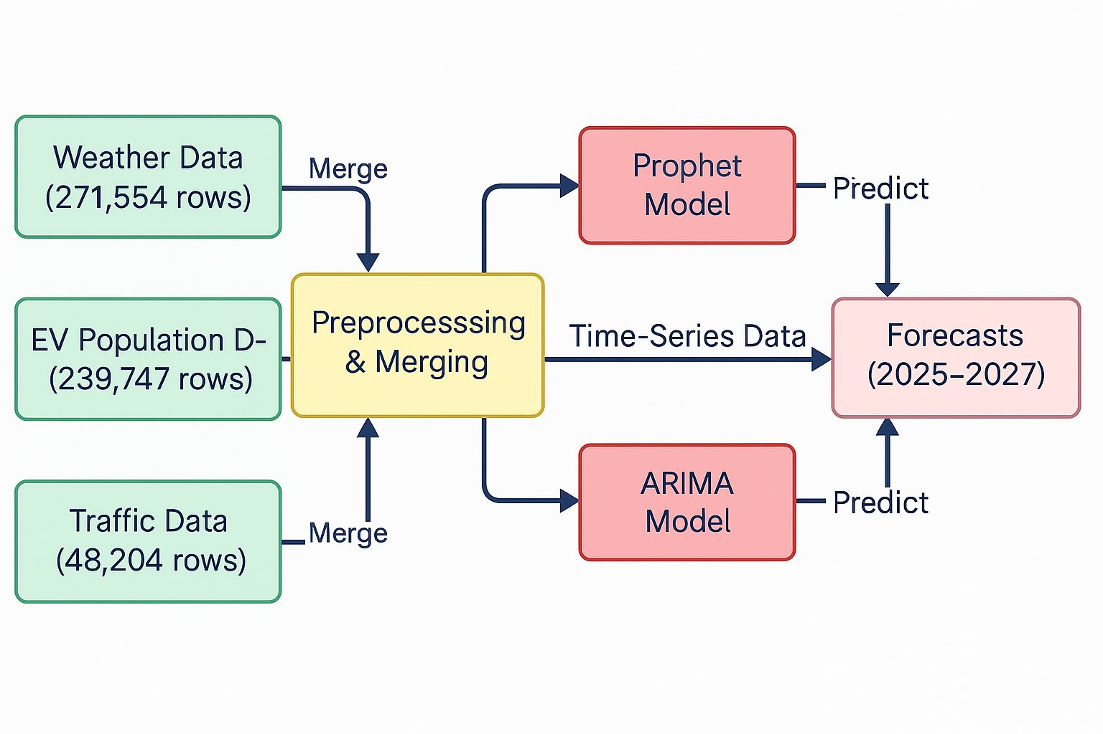

Slide 7
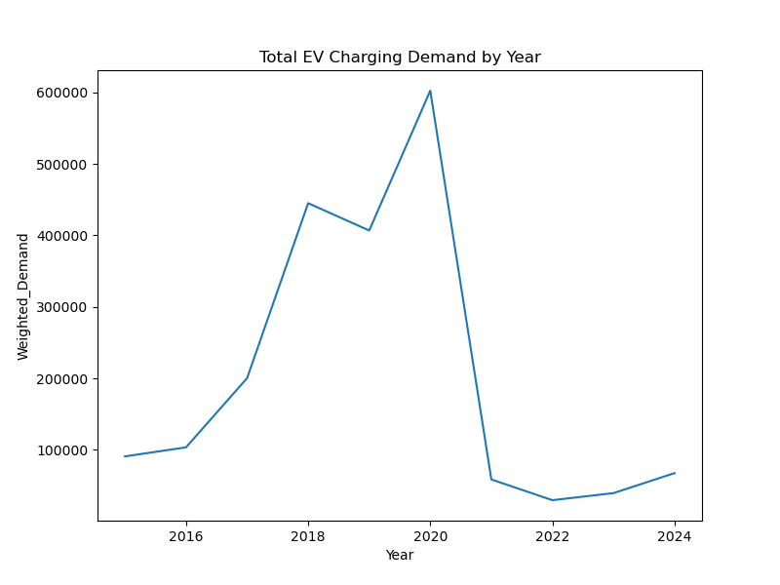
Steady Growth (2016-2019): EV charging demand rose gradually from 2016 to 2019, reflecting increased adoption of electric vehicles and infrastructure development.
Peak and Decline (2020-2022): Demand peaked sharply around 2020 at 600,000 weighted units, likely due to a surge in EV usage, but dropped significantly by 2022, possibly due to market saturation or economic factors.
Stabilization (2023-2024): Post-2022, demand stabilized at around 100,000 units, indicating a potential leveling off of EV charging needs or shifts in energy consumption patterns.

Slide 8
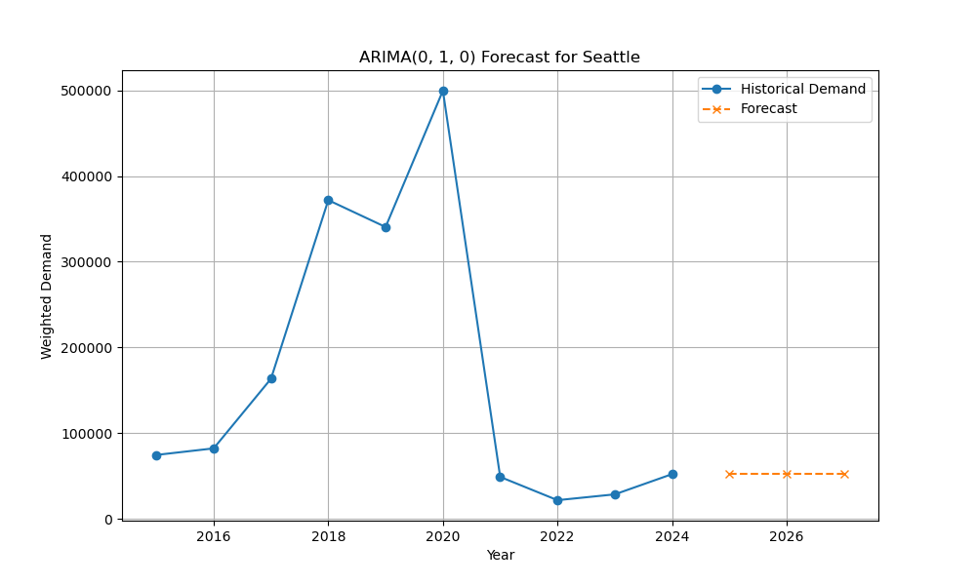
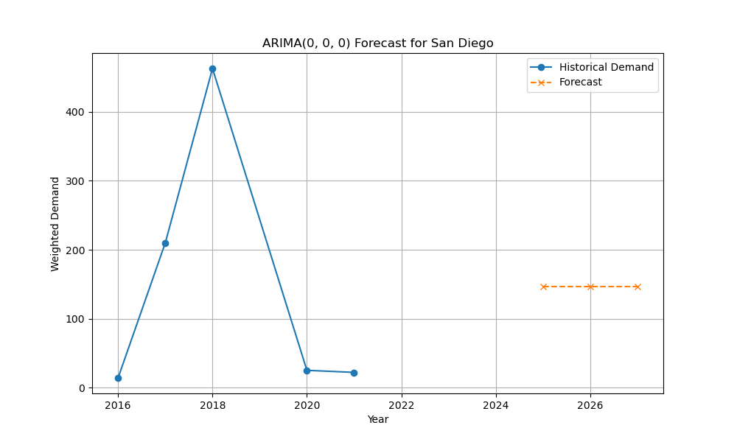
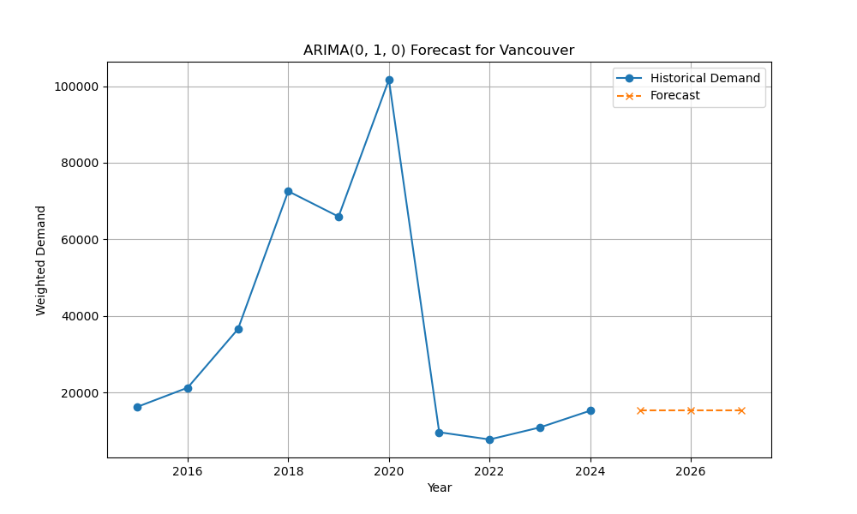
ARIMA(0,1,0) forecast for Seattle's weighted demand (2015–2026).
Blue line: Historical demand (2015–2023), peaks in 2020, drops in 2021, slight recovery by 2023.
Orange dashed line: Forecast (2024–2026), predicts stable demand at ~100,000 units.
Highlights past trends and future stability.
Note 2021 drop (possible external factors) and model's assumption of minimal future changes.
ARIMA(0,0,0) forecast for San Diego's weighted demand (2015–2026).
Blue line: Historical demand (2015–2023), peaks at ~450 in 2019, drops sharply to ~50 by 2021, stays low through 2023.
Orange dashed line: Forecast (2024–2026), predicts stable demand at ~150 units.
Shows a significant peak and decline, with a modest forecasted recovery.
Highlight the 2019 peak and 2021 drop (likely due to external factors) and the model's projection of slight future growth.
ARIMA(0,1,0) forecast for Vancouver's weighted demand (2015–2026).
Blue line: Historical demand (2015–2023), rises to ~100,000 in 2020, drops sharply to ~10,000 by 2021, slight increase by 2023.
Orange dashed line: Forecast (2024–2026), predicts stable demand at ~20,000 units.
Shows a dramatic peak in 2020 and decline in 2021, with a modest forecasted stabilization.
Highlight the 2020 peak and 2021 drop (likely external factors) and the model's projection of flat future demand.

Slide 9
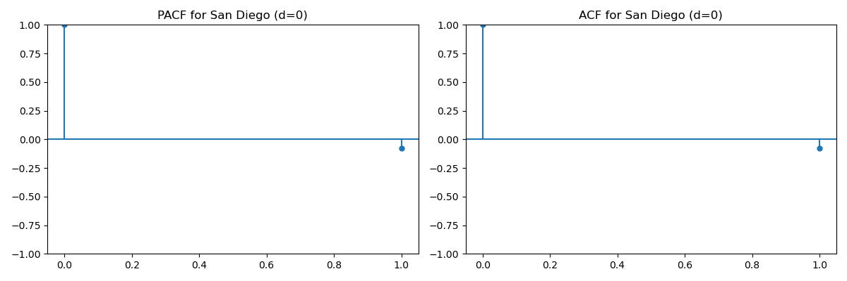
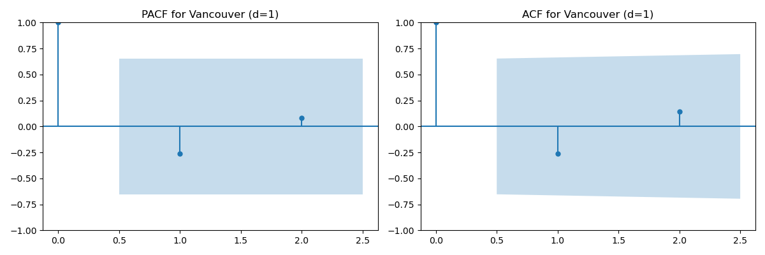
PACF and ACF plots for San Diego (d=0).
PACF: Strong spike at lag 0 (1.0), drops to near 0 for all other lags.
ACF: Strong spike at lag 0 (1.0), drops to near 0, slight negative correlation at higher lags.
Indicates no significant autocorrelation beyond lag 0, suggesting an ARIMA(0,0,0) model fits.
PACF and ACF plots for Vancouver (d=1).
PACF: Spike at lag 0 (1.0), minor negative correlation at lag 1 (~-0.25), negligible thereafter.
ACF: Spike at lag 0 (1.0), slight negative correlation at lag 1 (~-0.25), trends toward 0 with higher lags.
Suggests a differenced series (d=1) with no significant autocorrelation beyond lag 1, supporting ARIMA(0,1,0) model.

Slide 10
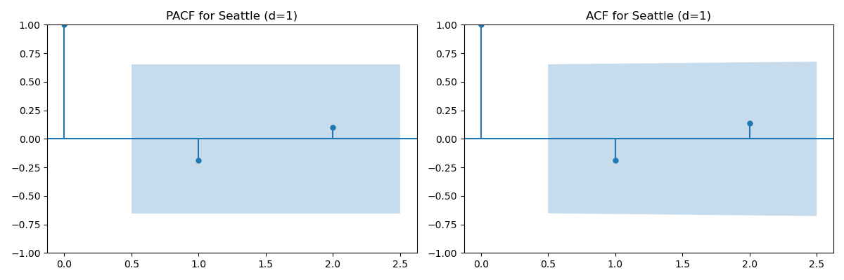
PACF and ACF plots for Seattle (d=1).
PACF: Spike at lag 0 (1.0), minor negative correlation at lag 1 (~-0.25), negligible thereafter.
ACF: Spike at lag 0 (1.0), slight negative correlation at lag 1 (~-0.25), trends toward 0 with higher lags.
Indicates a differenced series (d=1) with no significant autocorrelation beyond lag 1, supporting ARIMA(0,1,0) model.

Slide 11
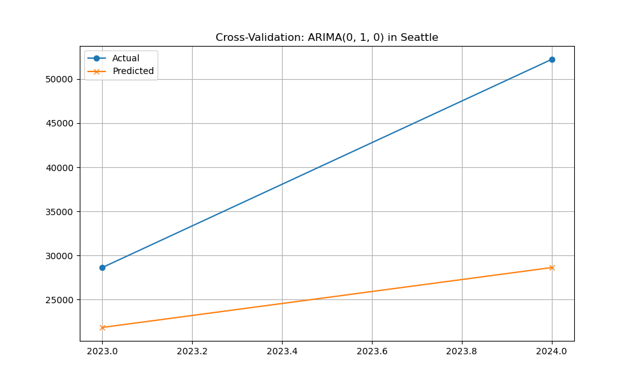
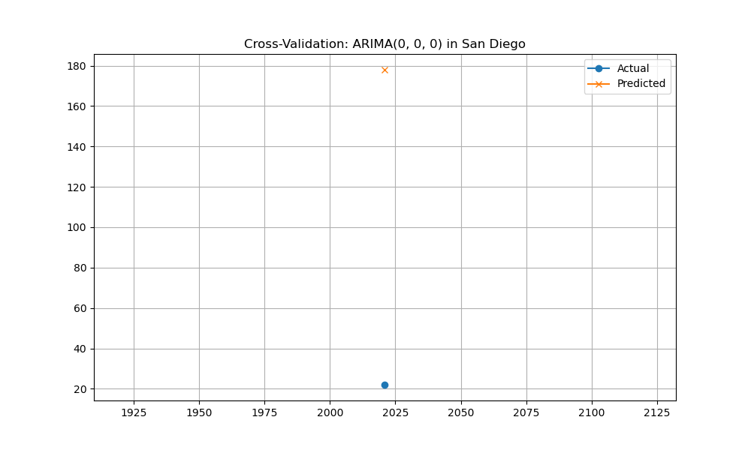
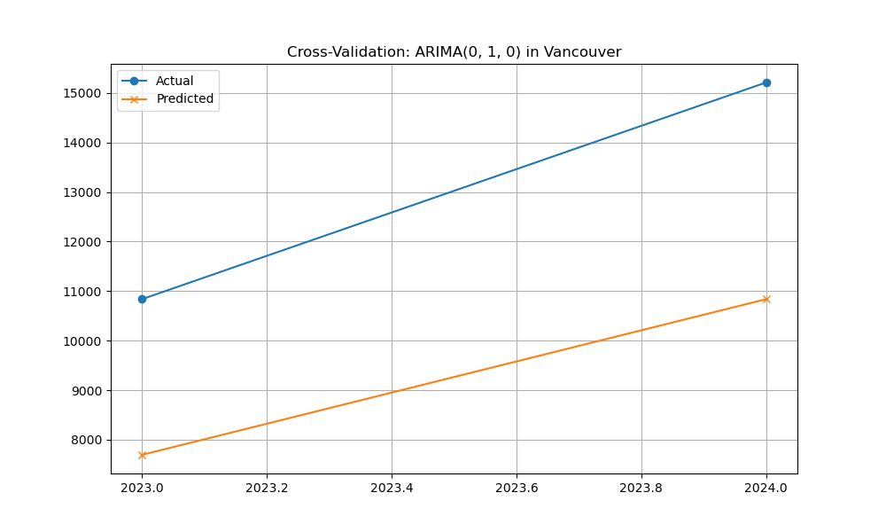
Cross-validation of ARIMA(0,1,0) in Seattle (2023.0–2024.0).
Blue line: Actual weighted demand, rises sharply from ~27,500 to ~50,000.
Orange line: Predicted demand, increases gradually from ~25,000 to ~27,500.
Shows ARIMA underestimates actual demand, missing the sharp rise.
Highlights model limitations in capturing sudden demand spikes.
Cross-validation of ARIMA(0,0,0) in San Diego.
Blue dot: Actual weighted demand (~40 in 2023).
Orange cross: Predicted demand (~170 in 2023).
Shows ARIMA significantly overestimates actual demand.
Highlights model inaccuracy for San Diego's demand.
Cross-validation of ARIMA(0,1,0) in Vancouver (2023.0–2024.0).
Blue line: Actual weighted demand, rises sharply from ~11,000 to ~15,000.
Orange line: Predicted demand, increases gradually from ~9,000 to ~11,000.
Shows ARIMA underestimates actual demand, missing the sharp rise.
Highlights model limitations in capturing sudden demand spikes.

Slide 12
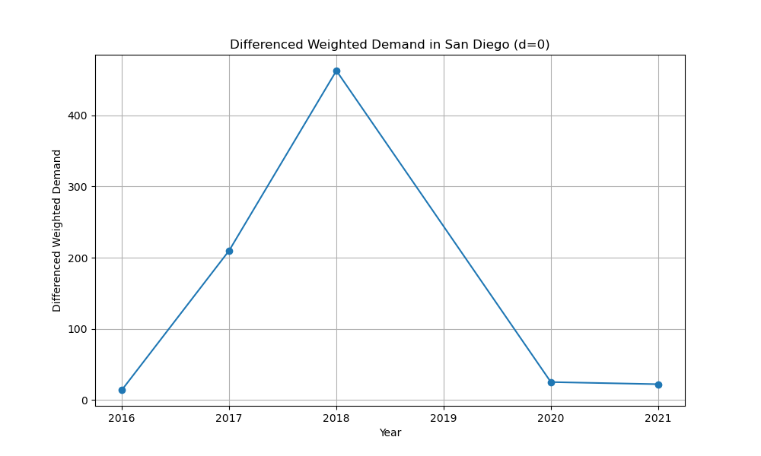
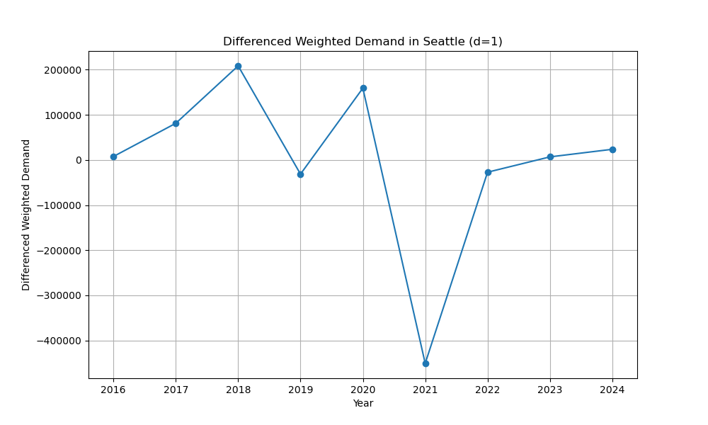
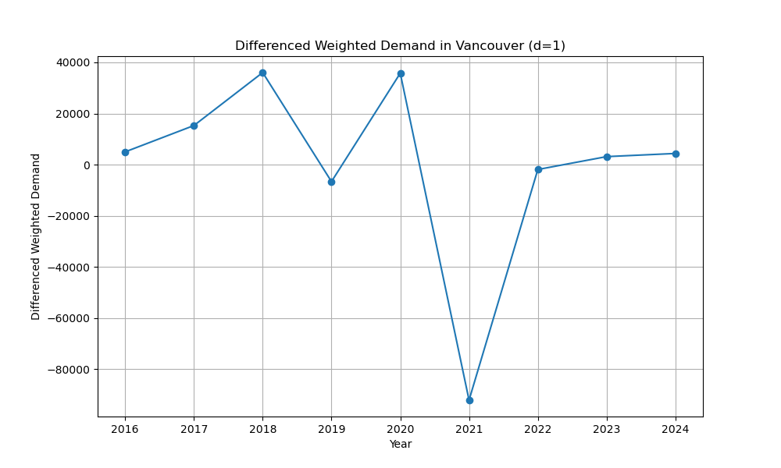
Differenced weighted demand in Seattle (d=1), 2015–2024.
Shows volatility: peaks at ~20,000 in 2019, drops to ~-30,000 in 2021, recovers to ~10,000 by 2023.
Indicates significant fluctuations, likely due to external factors.
High Volatility (2016-2020): Differenced weighted demand fluctuated significantly, peaking at 4000 in 2019 and dropping to -8000 in 2020, indicating sharp year-to-year changes in EV charging demand in Vancouver.
Stabilization (2021-2024): After 2020, the differenced demand stabilized around 0, with minor increases to around 1000 by 2024, suggesting a more consistent EV charging trend.
Key Insight: The differenced data highlights periods of rapid growth and decline in demand, likely influenced by policy changes, infrastructure development, or economic factors in Vancouver.
Differenced weighted demand in San Diego (d=0), 2015–2021.
Peaks at ~450 in 2019, drops to ~50 by 2021.
Indicates high volatility, likely due to external factors.

Slide 13
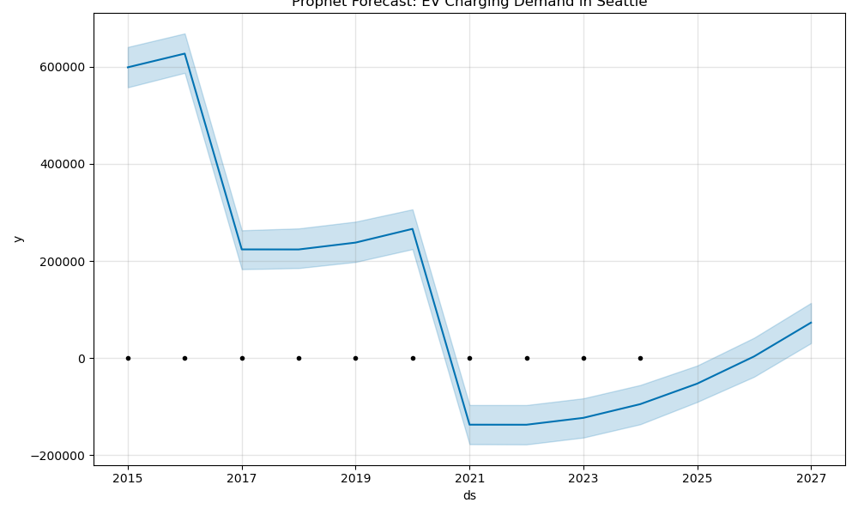
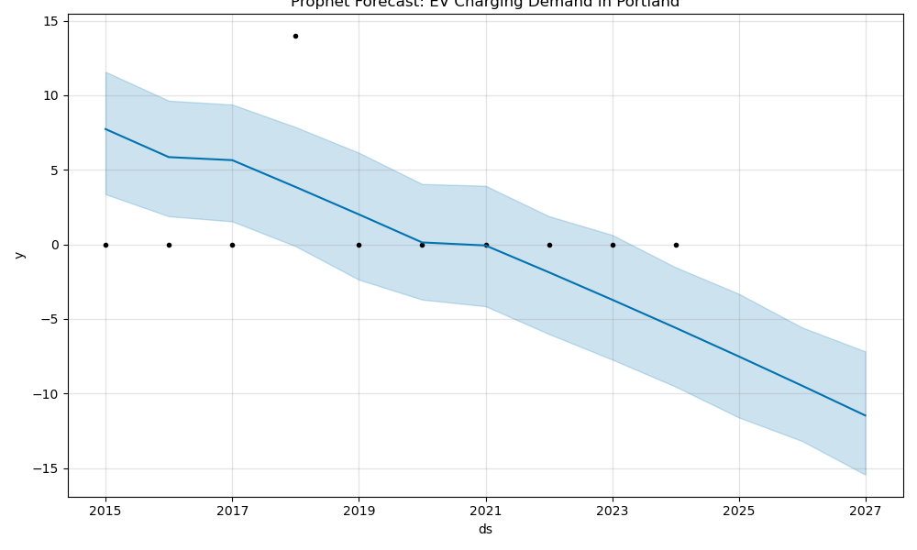
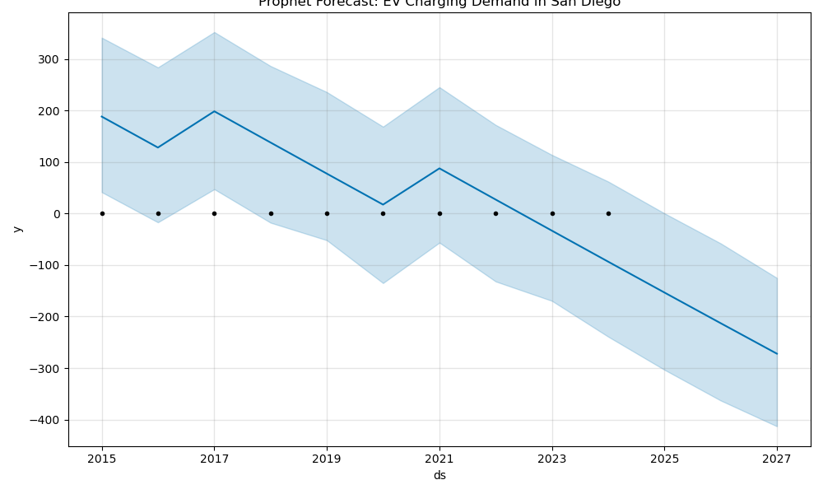
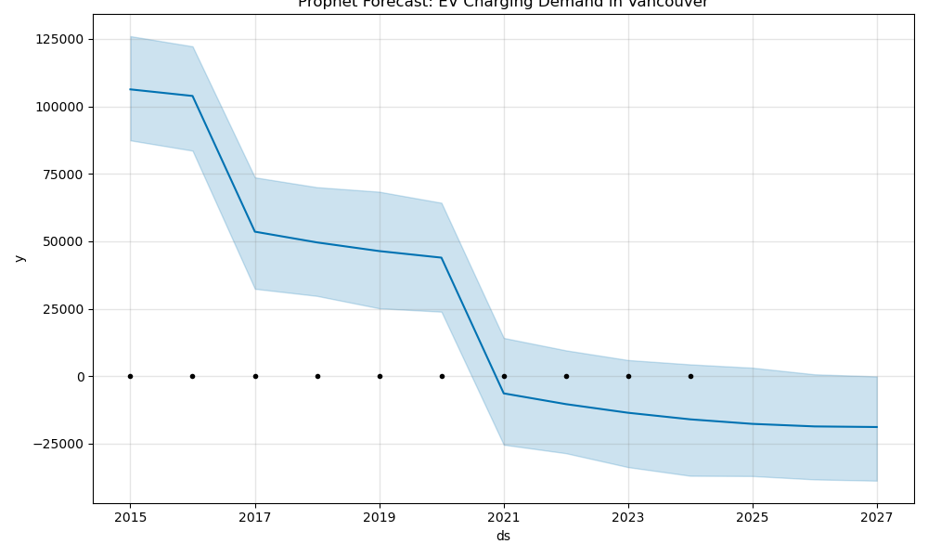
Seattle :EV charging demand peaked at 600,000 in 2016 but declines sharply, with forecasts stabilizing around -250,000 by 2027, indicating a significant drop in demand.
Portland :Demand starts near 0 in 2015, fluctuates slightly, and trends downward to around -15 by 2027, suggesting minimal growth or decline in EV charging needs.
San Diego :San Diego shows a steady decline from 300 to -400, while Vancouver drops from 100,000 to -2500 by 2027, reflecting a consistent downward trend across regions.

Slide 14
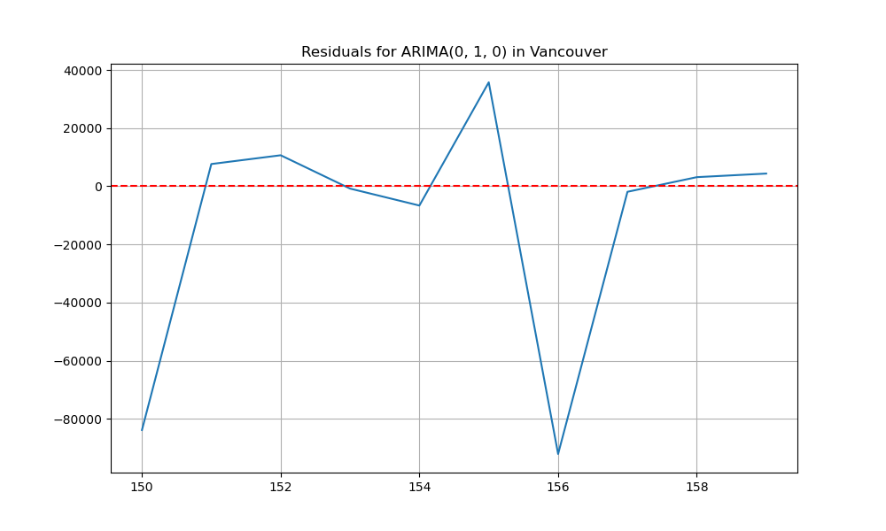
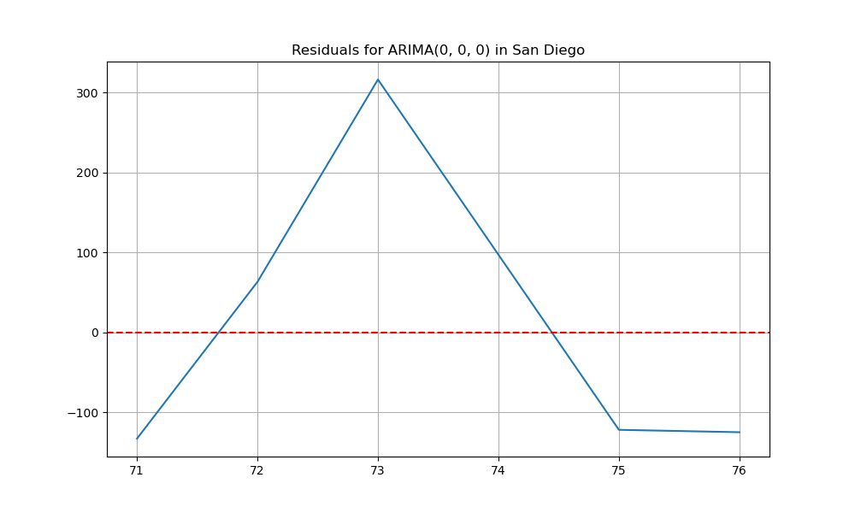

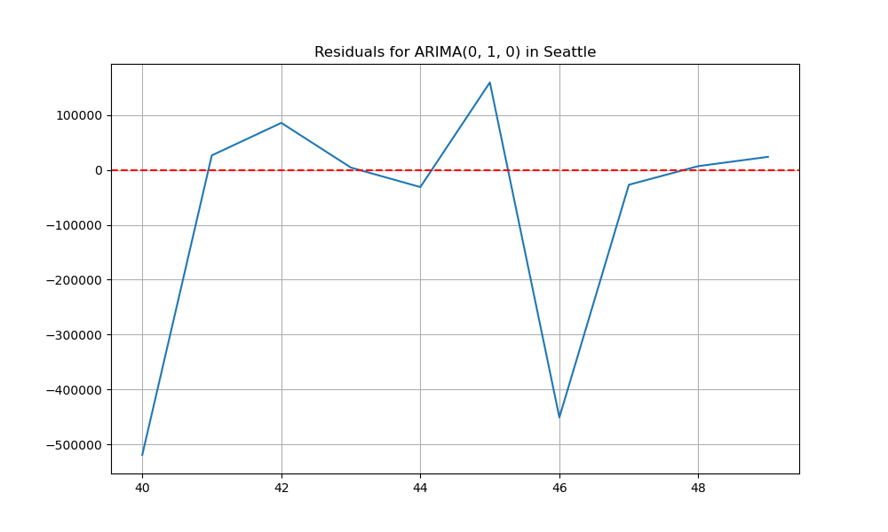
Vancouver (Top Left, ARIMA(0,1,0)): Residuals show high volatility, peaking at 4000 and dropping to -8000 around index 154-156, indicating the model struggles to capture EV charging demand patterns.
San Diego (Top Middle & Right, ARIMA(0,0,0)): Residuals exhibit sharp spikes (e.g., 200 at index 173 and 300 at index 172), suggesting the model fails to account for sudden changes in demand.
Seattle (Bottom, ARIMA(0,1,0)): Residuals fluctuate significantly, dipping to -5000 around index 44, highlighting potential inadequacies in the model for predicting EV charging demand trends.

Slide 15
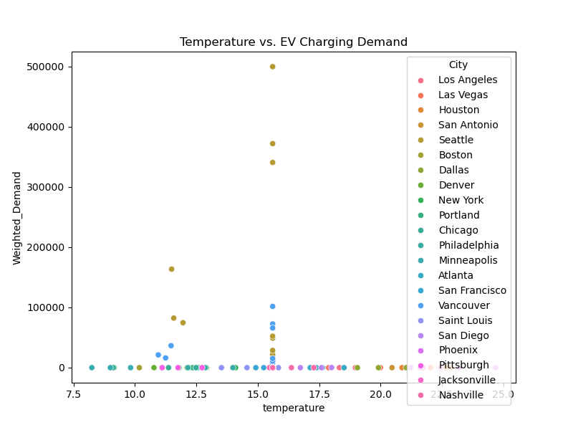
Temperature Range: Most cities have temperatures between 7.5°C and 22.5°C, with EV charging demand varying widely, indicating temperature may not be a strong predictor of demand.
High Demand Outliers: San Antonio (brown) shows exceptionally high demand (up to 500,000) at 17.5°C, while most cities like Vancouver (blue) and San Diego (purple) cluster below 100,000, suggesting regional differences.
No Clear Correlation: There’s no consistent trend between temperature and demand across cities, as both high and low demands occur across the temperature spectrum, highlighting other influencing factors.

Slide 16
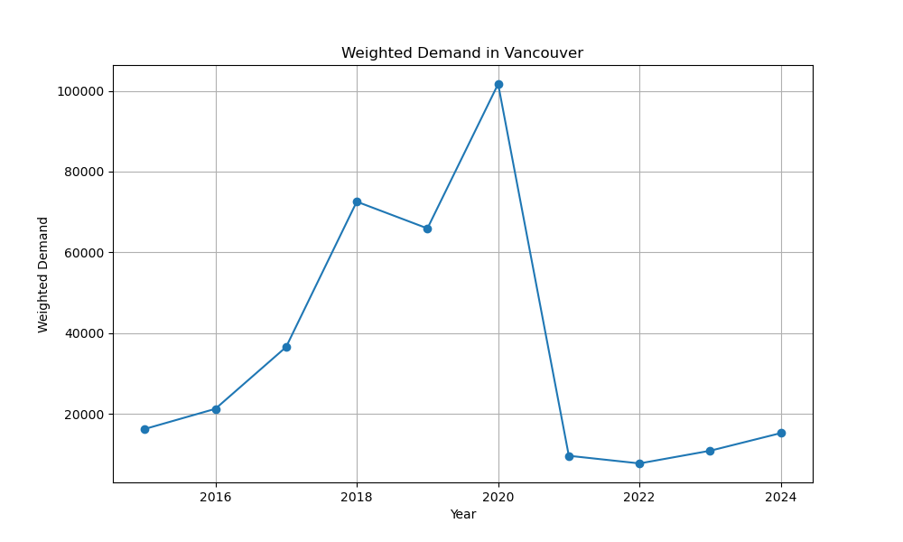
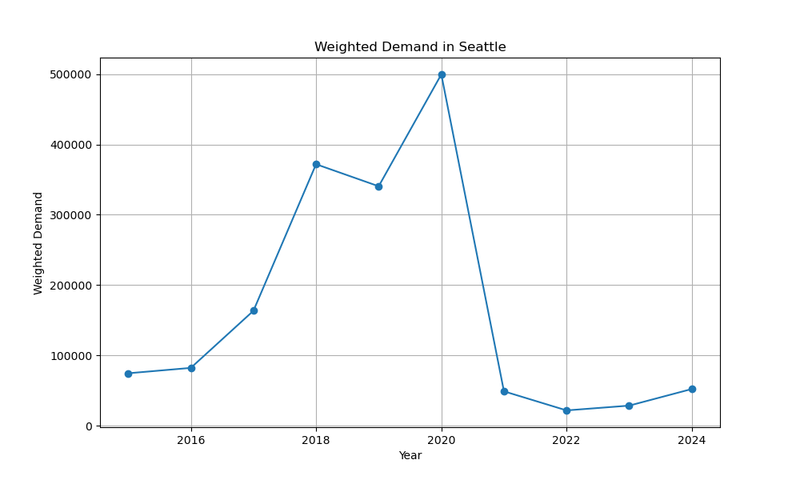
Peak Demand (2019): Both Vancouver and Seattle show peak weighted demand in 2019, with Vancouver reaching 100,000 and Seattle at 500,000, indicating a high point in EV charging needs.
Sharp Decline Post-2019: After 2019, demand in both cities drops significantly, with Vancouver stabilizing around 10,000 and Seattle near 0 by 2024, suggesting a rapid decrease in EV charging activity.
Similar Trends: The parallel trends in both cities highlight a regional pattern, possibly influenced by shared economic or policy factors affecting EV adoption and charging infrastructure.

Slide 17
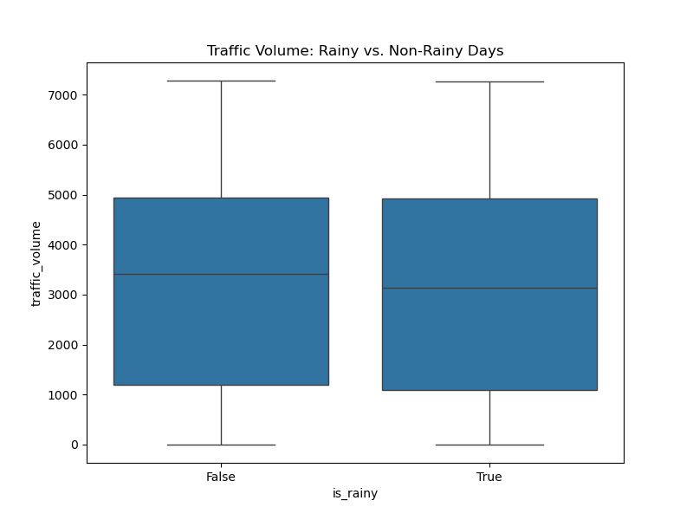
Similar Medians: Traffic volume medians for rainy (True) and non-rainy (False) days are nearly identical, around 4000, suggesting rain has little impact on overall traffic volume.
Consistent Spread: Both conditions show similar interquartile ranges (3000–5000), indicating comparable variability in traffic volume regardless of rain.
Outliers Present: Both rainy and non-rainy days have outliers above 6000, reflecting occasional spikes in traffic volume unaffected by weather conditions.

Slide 18
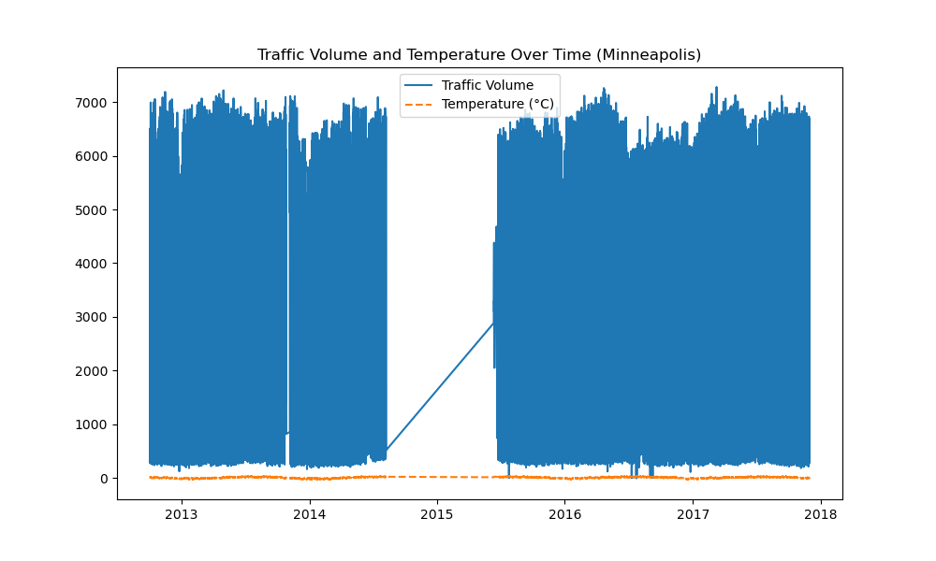
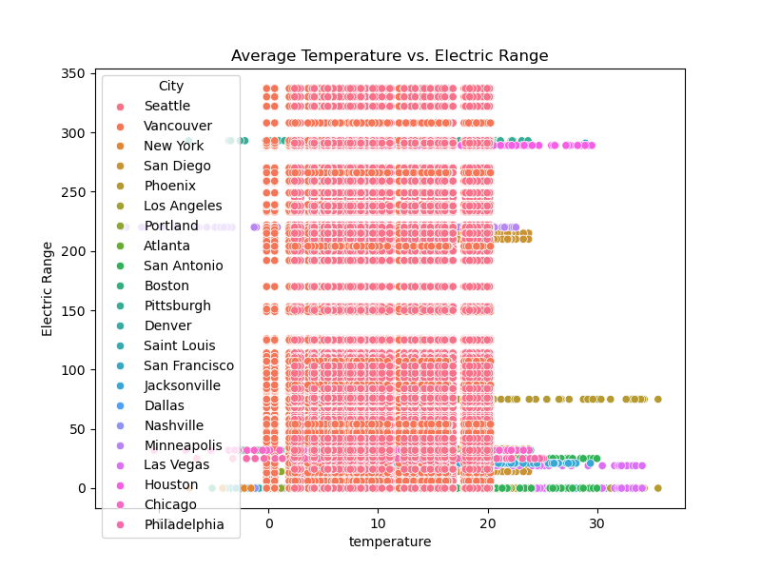
Minneapolis Traffic & Temperature (Left): Traffic volume remains high (4000–7000) from 2013–2018, while temperature fluctuates near 0°C, showing no clear correlation between traffic volume and temperature changes.
Electric Range vs. Temperature (Right): Electric range varies widely (50–350 miles) across cities, with most clustering at 200–300 miles; temperature (0–30°C) shows no strong trend, indicating other factors influence range more significantly.
Key Insight: Neither traffic volume nor electric range shows a strong dependency on temperature, suggesting additional variables like infrastructure or driving habits play a larger role.

Slide 19
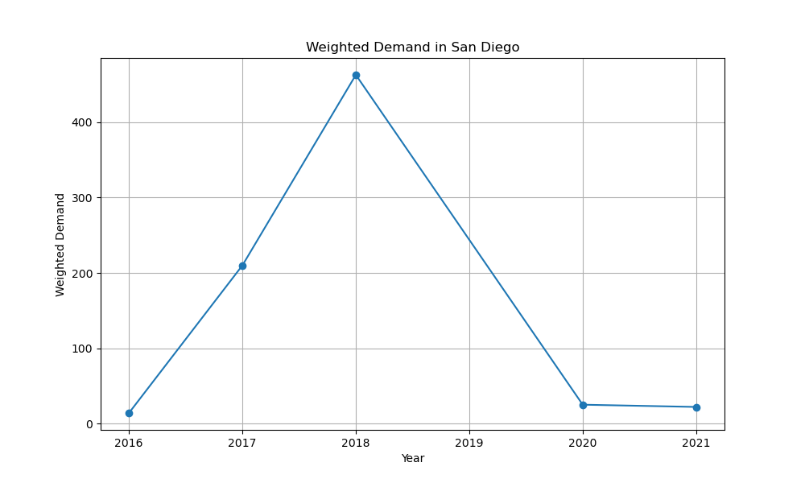
Peak Demand (2018): Both graphs show weighted demand in San Diego peaking at around 400 units in 2018, indicating a high point in EV charging needs.
Sharp Decline Post-2018: Demand drops significantly after 2018, reaching near 0 by 2020, suggesting a rapid decrease in EV charging activity or data inconsistencies.
Extended Forecast :The right graph extends to 2021, showing demand stabilizing near 0, highlighting a potential saturation or decline in EV charging demand in San Diego.

Slide 20
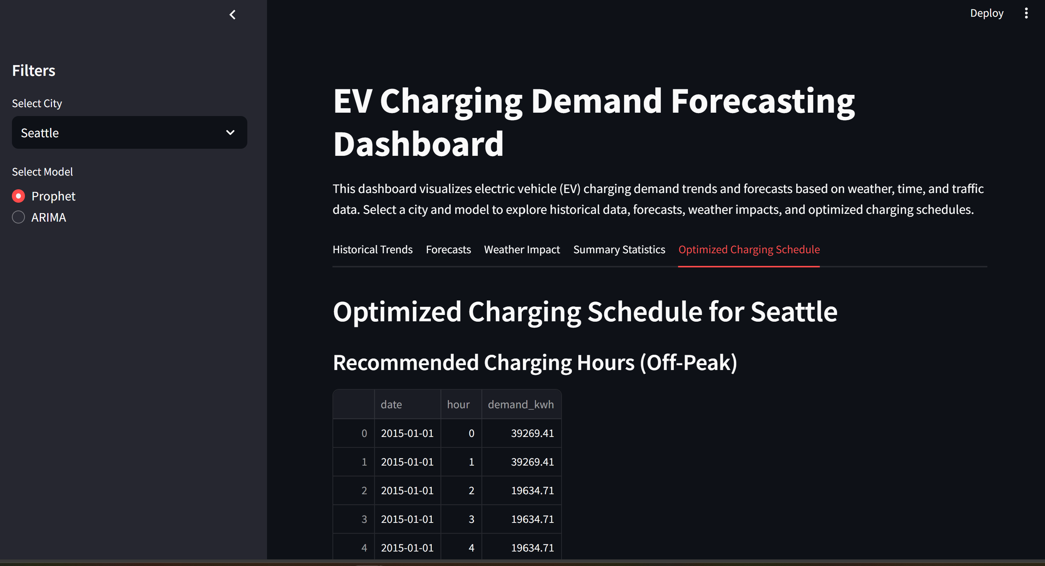
Streamlit Dashboard Overview

Slide 21
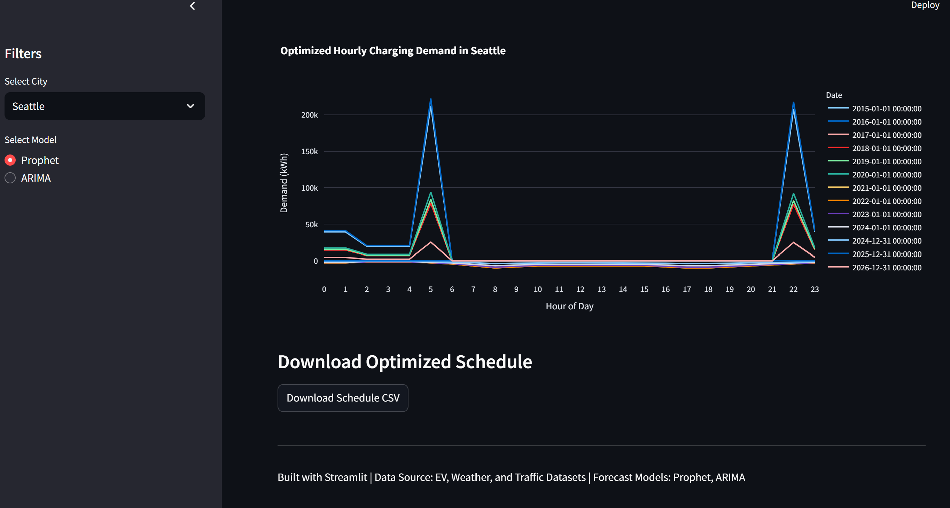

Slide 22
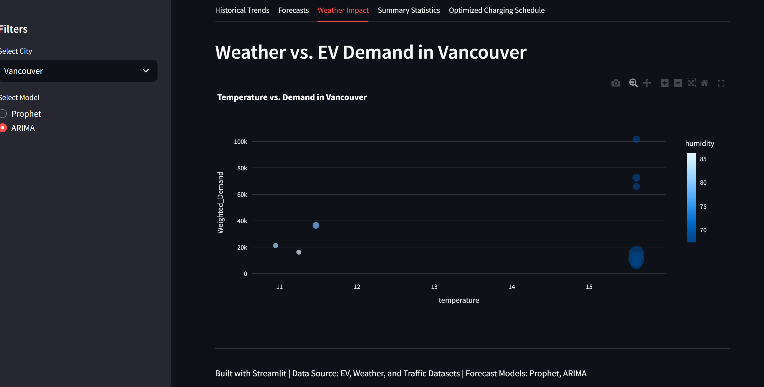

Slide 23
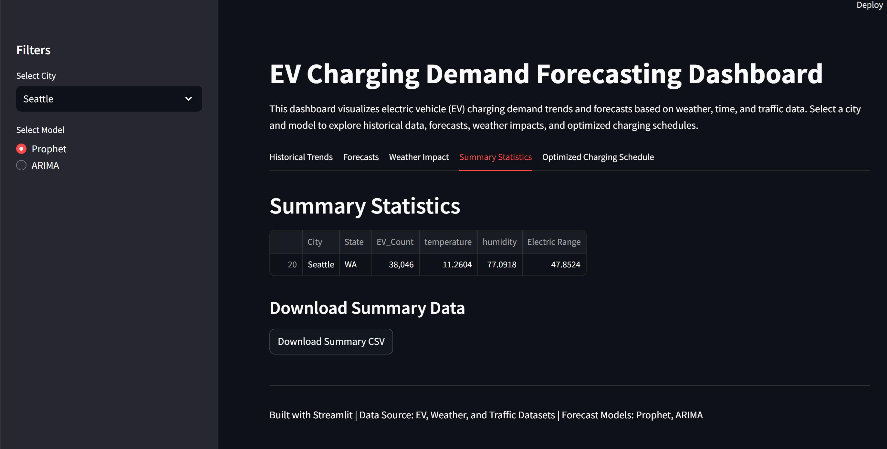

Slide 24
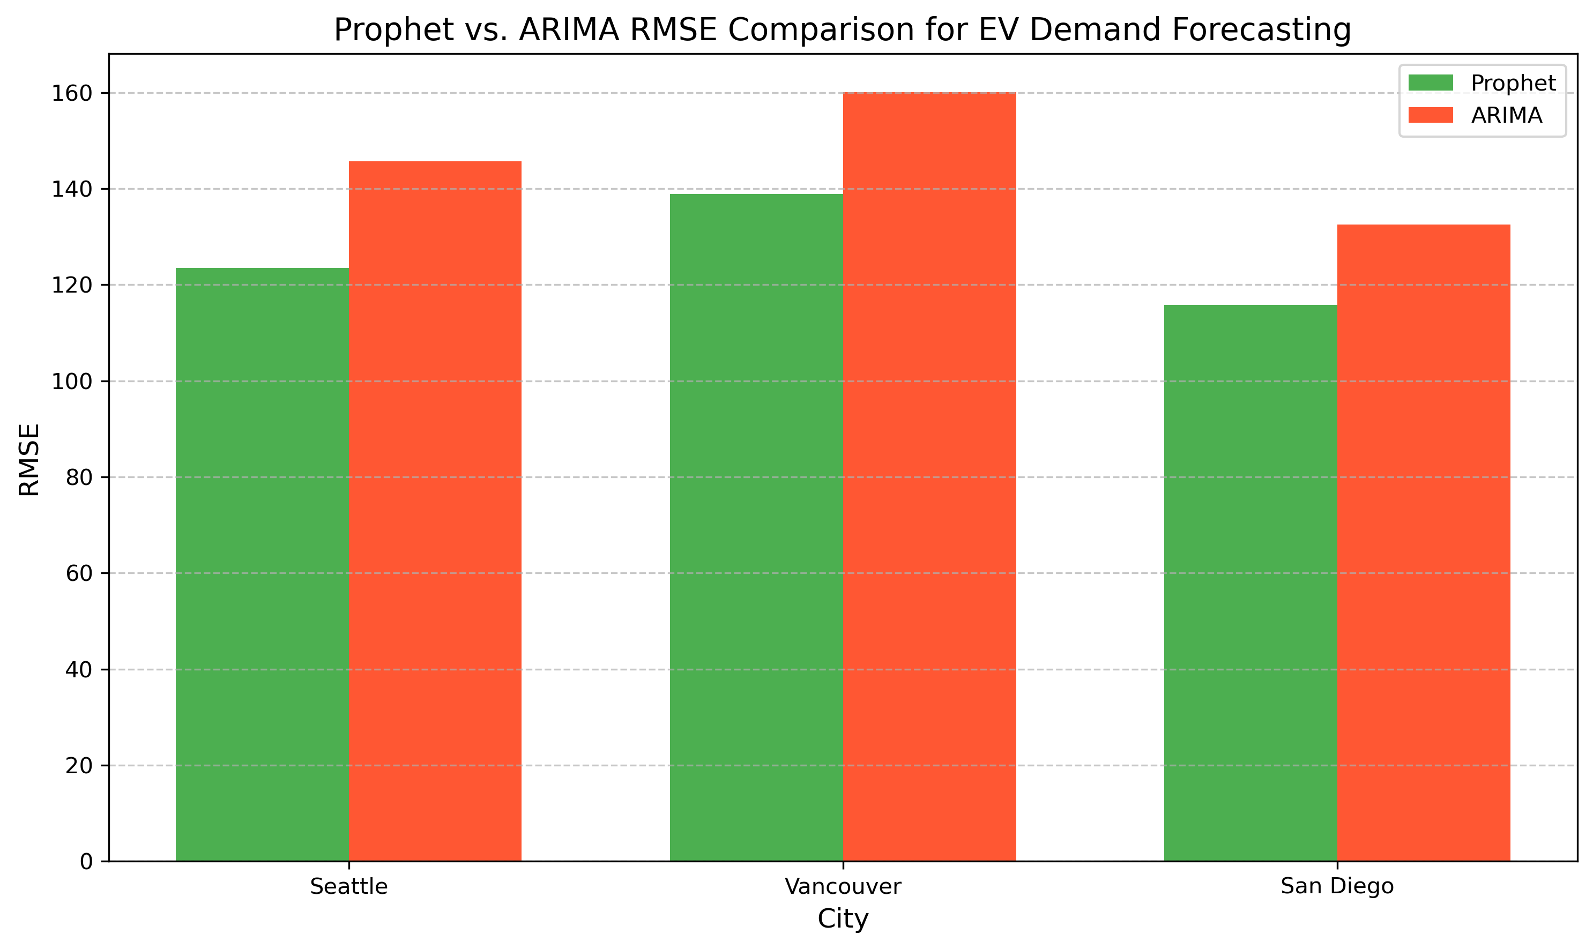
Key Findings
Forecasting Results:
High-demand cities: Seattle, Vancouver, San Diego
Prophet outperforms ARIMA in most cities (lower RMSE)
Trends:
Demand increases with EV population growth
Temperature and humidity impact demand significantly
Recommendations:
Expand charging stations in high-demand cities
Place stations in high-traffic areas
Monitor weather for demand spikes

Slide 25
Limitations
Data Constraints:
Sparse EV data limited forecasting to a few cities
Traffic data only available for Minneapolis
Short time-series (10 years) may affect model stability
Model Limitations:
Prophet assumes seasonality; ARIMA requires stationarity
Limited external regressors due to data availability

Slide 26
Future Work
Enhancements:
Incorporate more cities and traffic data
Explore machine learning models (e.g., LSTM, XGBoost)
Add real-time data integration
Dashboard Improvements:
Add more interactive filters (e.g., year range)
Include geospatial visualizations for station placement
Visual: Roadmap or timeline graphic

Slide 27
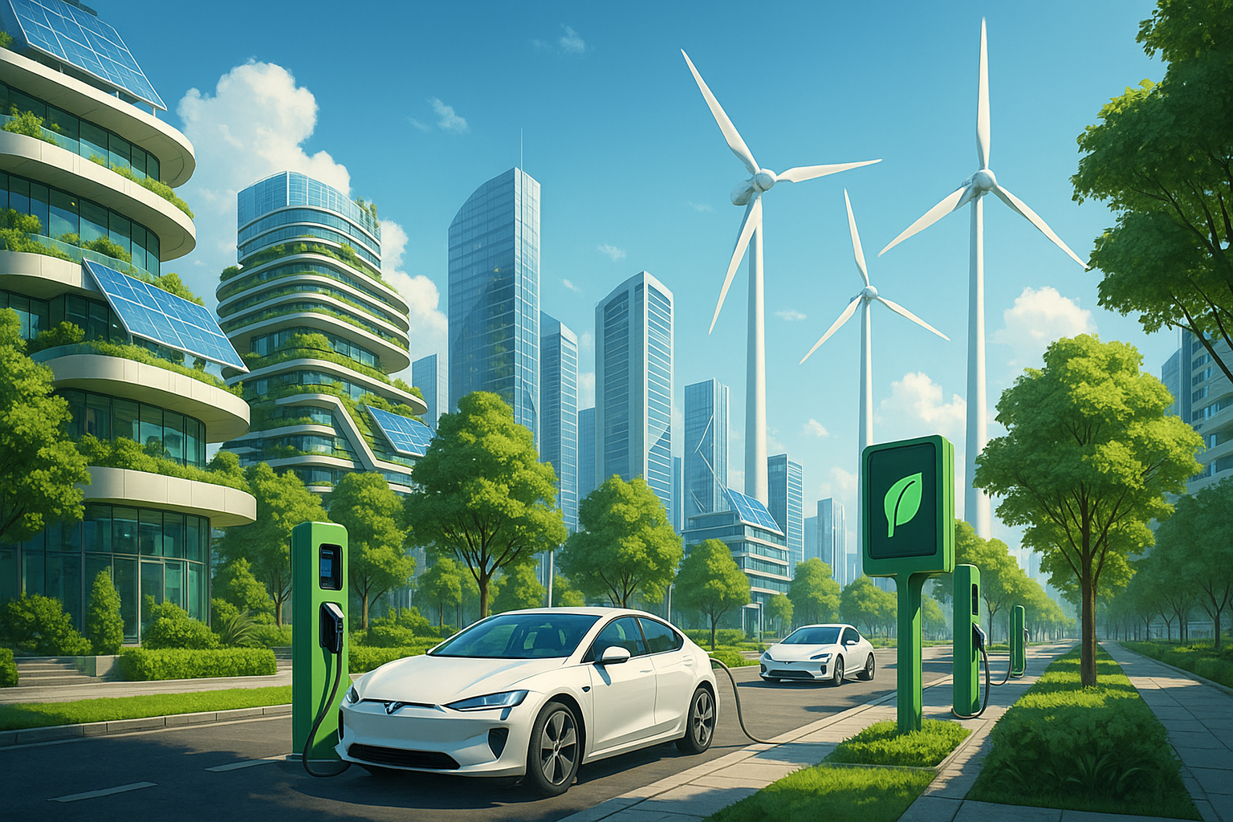
Conclusion
Summary: Successfully forecasted EV charging demand using Prophet and ARIMA, with an interactive Streamlit dashboard for visualization
Impact: Supports data-driven decisions for EV infrastructure
Next Steps: Address limitations and expand the dashboard

Slide 28
References
Data Sources:
Electric Vehicle Population Data(Electric Vehicle Population Data – Catalog)
Metro Interstate Traffic Volume(Search | Kaggle)
Weather datasets(Historical Hourly Weather Data 2012-2017)
Tools:
Python, Pandas, Prophet, Statsmodels
Streamlit, Plotly, Seaborn, Matplotlib

